Slide 1
ARM – Architecture, MODES & Register file
Embedded Systems

Slide 2
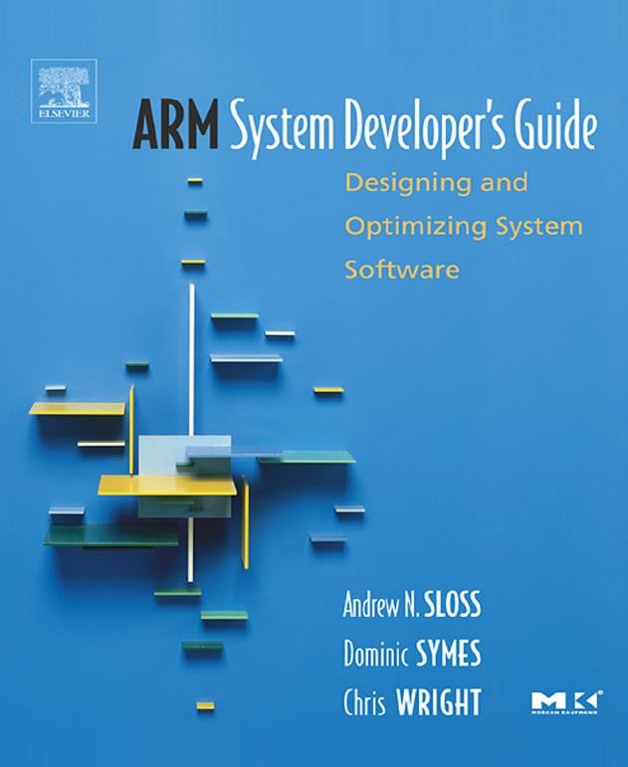
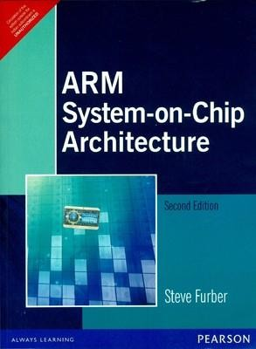

Slide 3
Agenda
Architecture
Modes
Registers
CPSR and SPSR

Slide 4
What is ARM?
ARM processor is basically a 32-bit processor, meant particularly for high end applications which involve more complex computation and calculations.
ARM processor was first developed at “ACORN computer Limited” of Cambridge, England between 1983 and 1985 just after 1980 when the concept of RISC was introduced at Stanford and Berkley. (ARM – Acorn RISC Machine)
ARM specializes in the concept of ARM core, which they have licensed to number of other manufacturers to make a variety of chips around the same processor core. (Means, I tell you how to make, you make it in your name!)

Slide 5
Architectural Inheritance
At the time the first ARM chip was designed, the only examples of RISC architectures were the Berkeley RISC I and II and the Stanford MIPS.
The ARM architecture incorporated a number of features from the Berkeley RISC design, but a number of other features were rejected.
Those that were used were:
• a load-store architecture;
• fixed-length 32-bit instructions;
• 3-address instruction formats.
Those that were Rejected were:
Register Window
Delayed Branches
Single-cycle execution of all instructions.

Slide 6
Features of Basic RISC Architecture
A Large Uniform Register File
Load-Store Architecture, where data processing operates on register content only
Uniform & fixed length Instructions
32-bit processor
Instructions are 32-bit long
Good Speed/Power Consumption Ratio
High Code Density
The ARM is based on RISC architecture, but it is not a purely RISC architecture because it has been enhanced to meet the requirement of embedded applications. → Versatility!
The requirements for embedded applications are basically high code density, low power consumption as well as low and smaller silicon footprint. Architecturally ARM satisfies various conditions and properties of RISC processors as well.

Slide 7
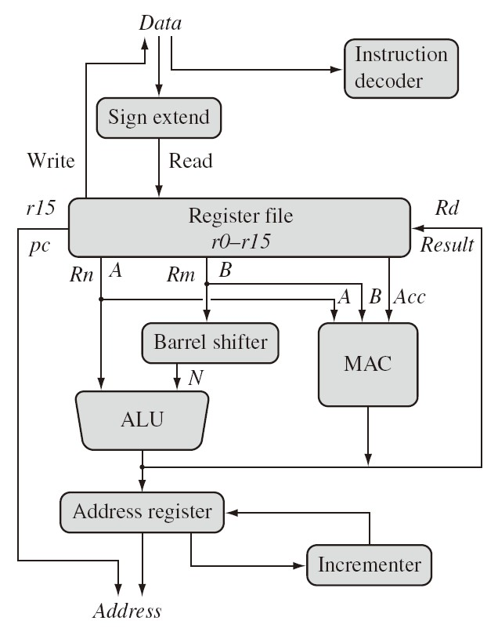
ARM core Dataflow Model
The sign extend hardware converts signed 8-bit and 16-bit numbers to 32-bit values as they are read from memory and placed in a register (for signed values), fill zeros if
unsigned
Mem Mem
Source operands (Rn & Rm) are read from the register file using the internal buses A and B, respectively and result Rd is written back
The PC value is in the address register, which is fed into the incrementer, then the incremented value is copied back into rl5
It is also written into address register to be used as the address for the next instruction fetch
A[31:0]

Slide 8


ARM Core Dataflow Model … contd
The ALU (arithmetic logic unit) or MAC (multiply-accumulate unit) takes the register values Rn and Rm from the A and B buses and computes a result
Data processing instructions write the result in Rd directly to the register file
Load and store instructions use the ALU to generate an address to be held in the address register and broadcast on the Address bus
Mem Mem
A[31:0]

Slide 9

ARM Core Dataflow Model … contd
One important feature of the ARM is that register Rm alternatively can be
preprocessed in the barrel
shifter before it enters the ALU
Mem Mem
The barrel shifter and ALU can calculate together a wide range of expressions and addresses in the same cycle
For load and store instructions the incrementer updates the address register before the core reads or writes the next register value from or to the next sequential memory location
A[31:0]

Slide 10
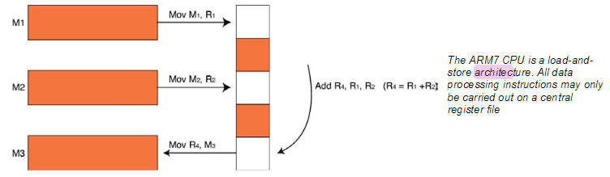
Programmers Model – Register Architecture
The ARM7 is a load-and-store architecture, so in order to perform any data processing instructions the data has first to be moved from the memory store into a central set of registers, the data processing instruction has to be executed and then the data is stored back into memory. (This is Load and Store, Recollect the past)

Slide 11
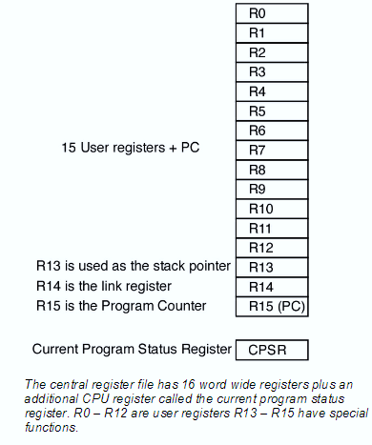
Registers
The central set of registers are a bank of 16 user registers R0 – R15.
Each of these registers is 32 bits wide and R0 – R12 are user registers in that they do not have any specific other function. (Means, general purpose registers)
The Registers R13 – R15 do have special functions in the CPU.
R13 is used as the stack pointer (SP).
R14 is called the link register (LR).
When a call is made to a function the return address is automatically stored in the link register and is immediately available on return from the function.
R15 is the program counter (PC).

Slide 12
Processor Modes
User
Unprivileged Mode
Most tasks run on this mode
FIQ
Entered when a high priority Interrupt is occurred
IRQ
Entered when a low priority interrupt (normal) is occurred
Supervisory
Entered on Reset
Entered on Software Interrupt
Abort
To handle memory access violations
Undefined
To handle un-defined instructions
System
Privileged mode using the same registers as user mode

Slide 13
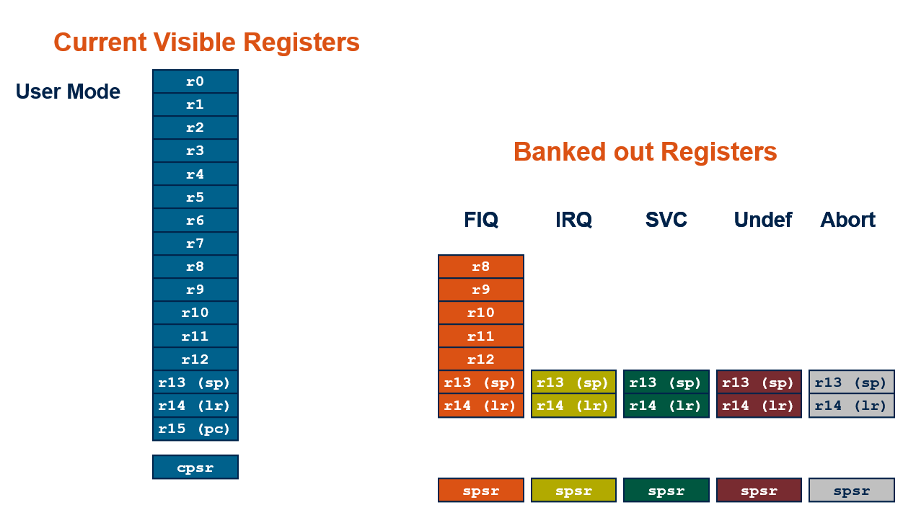
ARM Register Set

Slide 14
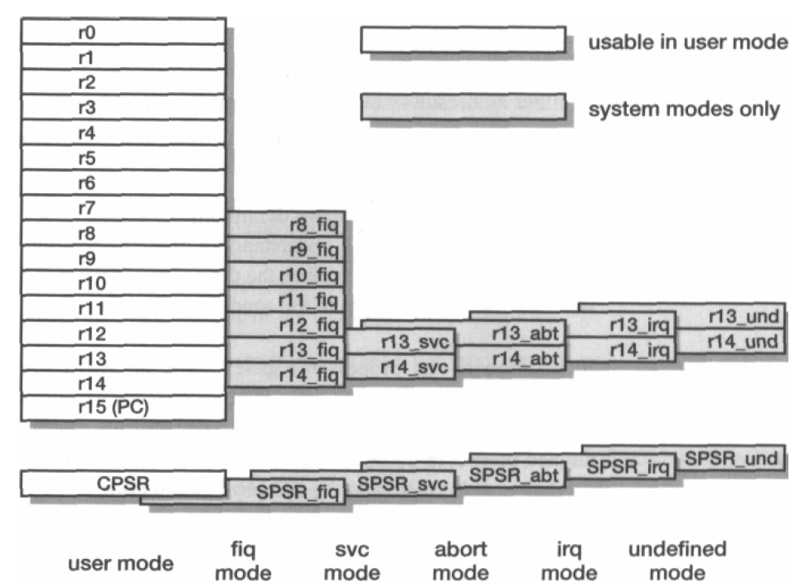
ARM Register Set
PC / R15 – 1 (common for all modes)
R0 – R12 – 13 (common for 6 modes)
R8_fiq to R12_fiq – 5 (Only for FIQ)
R13 and R14 – 2 (Common for 2 modes)
Copies of R13 and R14 – 10 (2 x 5 modes)
CPSR – 1 (Common for all modes)
SPSRs – 5 (For all exception modes)
----------------------------------------------
Total : 37 registers

Slide 15
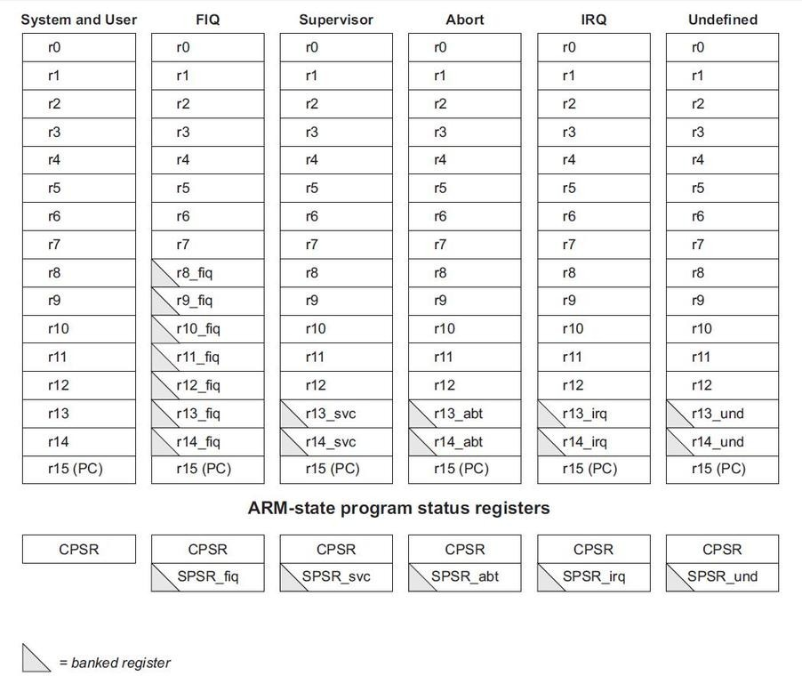
ARM’s Visible Registers

Slide 16
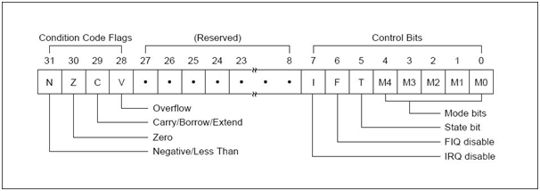
Current Program Status Register
Interrupt Disable bits.
I = 1: Disables the IRQ.
F = 1: Disables the FIQ.
T Bit
Architecture xT only
T = 0: Processor in ARM state
T = 1: Processor in Thumb state
Mode bits
Specify the processor mode
Condition code flags
N = Negative result from ALU
Z = Zero result from ALU
C = ALU operation Carried out
V = ALU operation overflowed

Slide 17
CPSR and SPSR (Save Program status register)
All processor modes except system and user mode have an SPSR.
Records the pre-exception value of the CPSR. (ARM Exceptions – Topic for upcoming session)
Upon taking an exception, the CPSR is copied to the SPSR of the processor mode the exception is taken to. This is useful because the exception handler is able to restore the CPSR to the value prior to taking the exception, as well as being able to examine the CPSR in general.

Slide 18
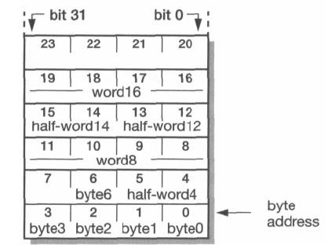
Memory organization & Supported Data Types
Little Endian Mode
0x1000 0010
0x1000 000C
ARM processors support 6 data types
8-bit signed and unsigned bytes
16-bit signed and unsigned half-words (aligned on 2-byte boundaries)
32-bit signed and unsigned words (aligned on 4-byte boundaries)
ARM instructions are all 32-bit words and must be word aligned
Internally all ARM operations are on 32-bit operands; the shorter data types are only supported by data transfer instructions
ARM7TDMI core can be configured to operate in big-endian mode if needed, where the most significant byte (MSB) of a word is stored at the lowest memory address.
0x1000 0000

Slide 19
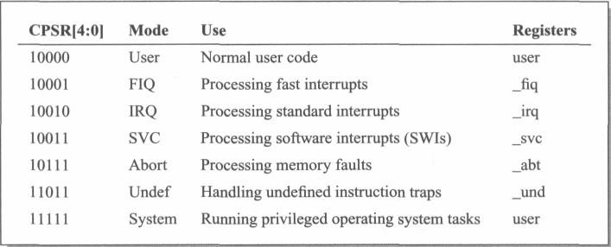
Processor mode bits in CPSR
The processor mode can be changed by a program that writes directly into the CPSR (if already in privileged mode) or by hardware when the core responds to an exception or interrupt
CPSR

Slide 20
Exception Handling
When an exception occurs, the ARM:
Copies CPSR into SPSR_<mode>
Sets appropriate CPSR bits
Change to ARM state
Change to exception mode
Disable interrupts (if appropriate)
Stores the return address in LR_<mode>
Sets PC to vector address
To return, exception handler needs to:
Restore CPSR from SPSR_<mode>
Restore PC from LR_<mode>
This can only be done in ARM state.
0x1C
FIQ
0x18
IRQ
0x14
(Reserved)
0x10
Data Abort
0x0C
Prefetch Abort
0x08
Software Interrupt
0x04
Undefined Instruction
0x00
Reset
Vector Table
Vector table can be at 0xFFFF0000 on ARM720T and on ARM9/10 family devices

Slide 21
Exceptions
Exceptions are usually used to handle unexpected events which arise during the execution of a program, such as interrupts or memory fault
ARM exceptions may be considered in three groups:
1. Exceptions generated as the direct effect of executing an instruction. Software interrupts, undefined instructions (including coprocessor instructions where the requested coprocessor is absent) and prefetch aborts (instructions that are invalid due to a memory fault occurring during fetch)
2. Exceptions generated as a side-effect of an instruction. Data aborts (a memory fault during a load or store data access) are in this class.
3. Exceptions generated externally, unrelated to the instruction flow. Reset, IRQ and FIQ

Slide 22
Exception entry
It changes to the operating mode corresponding to the particular exception.
It saves the address of the instruction following the exception entry instruction in r14 of the new mode.
It saves the old value of the CPSR in the SPSR of the new mode.
It disables IRQs by setting bit 7 of the CPSR and, if the exception is a fast interrupt, disables further fast interrupts by setting bit 6 of the CPSR.
It forces the PC to begin executing at the relevant vector address

Slide 23
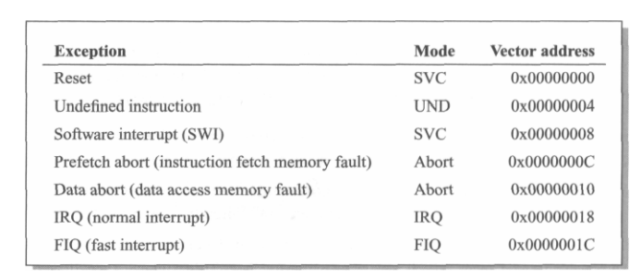
Exception vector addresses

Slide 24
Exception return
Once the exception has been handled the user task is normally resumed.
This requires the handler code to restore the user state exactly as it was when the exception first arose
Any modified user registers must be restored from the handler's stack.
The CPSR must be restored from the appropriate SPSR.
The PC must be changed back to the relevant instruction address in the user instruction stream.

Slide 25
Home Work ; Explore Cortex A , M and R Series

Slide 26
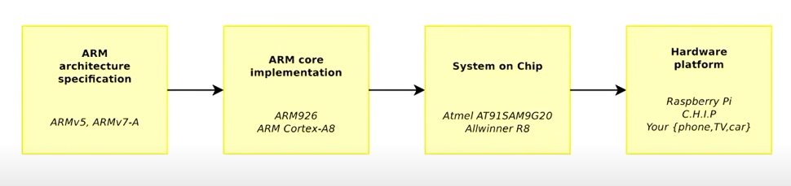
ARM ARCHITECTURE TO BOARD​

Slide 27
Instruction Pipeline of
ARM7TDMI
ARMxTDMI (Nomenclature/Classification)
x : 7 Series
T : Thumb mode is supported
D : Debugger unit present
M: Multiplier unit present
I : EmbeddedICE (built-in debugger hardware)

Slide 28
Pipelining Definitions
Pipelining is an implementation technique whereby multiple instructions are overlapped in execution. It is not visible to the programmer!
Each step is called a pipe stage or pipe segment
Pipeline machine cycle is the time required to move an instruction one step down the pipeline
Throughput of a pipeline: number of instructions that can leave the pipeline in each cycle
Latency is the time needed for an instruction to pass through all the pipeline stages

Slide 29

Pipeline Implementation
A task takes a total time of T
The task is divided into k subtasks (or stages) which are independent of each other
Each subtask (or stage) takes a time of T/k
Data transfers between stages are simultaneous
One task or operation enters the pipeline per cycle
After k cycles one instruction/task is completed per cycle (T/k)
Note: Pipelining is most suited for instruction processing since job of a processor is to execute streams of instructions continuously

Slide 30
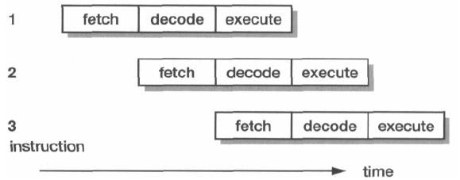
3-stage Pipeline Operation
ARM employs a simple 3-stage pipeline with the following pipeline stages
Fetch: The instruction is fetched from memory and placed in the instruction pipeline
Decode: The instruction is decoded and the datapath control signals prepared for the next cycle. In this stage the instruction 'owns' the decode logic but not the datapath
Execute: The instruction 'owns' the datapath; the register bank is read, an operand shifted, the ALU result generated and written back into a destination register

Slide 31
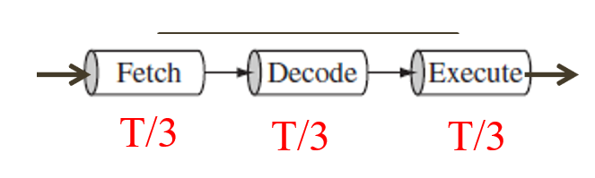
Pipeline Implementation
In a non-pipelined implementation a new instruction comes into the pipeline only after the previous instruction is fully executed.
i.e. the last stage is also completed
In a pipelined implementation of k stages
A new instruction is coming into the pipeline once the previous instruction is done with the first stage
The instructions come into the pipeline k times faster
The Clk is k times faster compared to non-pipelined processor
The memory interface also needs to perform k times faster

Slide 32
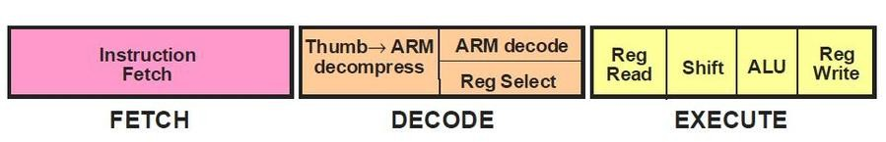
3-Stages of ARM7TDMI Pipeline

Slide 33
Instruction Pipeline
At any one time, three different instructions may occupy each of these stages, so the hardware in each stage has to be capable of operating independently
When the processor is executing simple data processing instructions, the pipeline enables one instruction to be completed every clock cycle (throughput)
An individual instruction takes three clock cycles to complete, so it has a three-cycle latency, but the throughput is one instruction per cycle

Slide 34
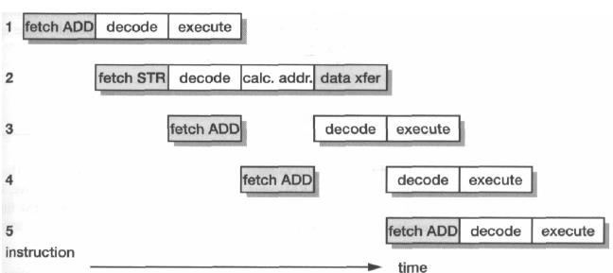
Instruction Pipeline … contd.
When a multi-cycle instruction is executed the flow is less regular as shown below
This shows a sequence of single-cycle ADD instructions with a data store instruction, STR, occurring after the first ADD
The cycles that access main memory are shown with light shading so it can be seen that memory is used in every cycle
Note: STR is a Store instruction to save the content of a register into memory

Slide 35
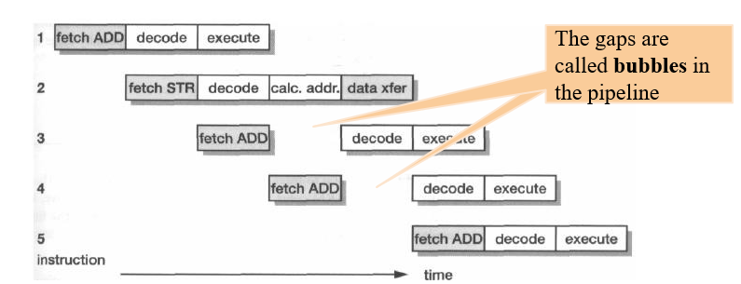
Instruction Pipeline … contd.
The datapath is likewise used in every cycle, being involved in all the execute cycles, the address calculation and the data transfer
The decode logic is always generating the control signals for the datapath to use in the next cycle
In addition to datapath control signals, control signals for the data
transfer should also be generated for the load/store instructions

Slide 36
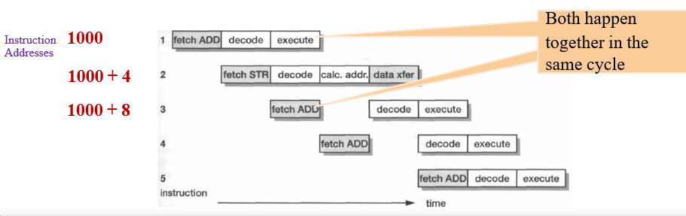
Instruction Pipeline Explained
Thus, in this instruction sequence, all parts of the processor are active in every cycle and the memory is the limiting factor
Memory determines the number of cycles the sequence of instructions in the pipeline take
During the Execute cycle of each instruction a fetch for the next instruction but one (PC + 8)
is issued by the processor
Branch instructions flush and refill the instruction pipeline

Slide 37
PC (r15) Behaviour
One consequence of the pipelined execution model used in the ARM is that the Program Counter, which is visible to the user as r15, must run ahead of the current instruction
Instructions fetch the next instruction but one during their first cycle, this suggests that the PC must point eight bytes (two instructions) ahead of the current instruction in execution
Caution: Programmer who attempts to access the PC directly through r15 must take into account of the exposure of the pipeline
Even more complex behaviour is exposed if r15 is used later than the first cycle of an instruction, since the instruction would have itself incremented the PC during its first cycle. Such uses are ‘unpredictable’ as per ARM Arch definition

Slide 38
Other Characteristics of Pipeline
Execution of a branch instruction or branching by the direct modification of the PC causes the ARM core to flush its pipeline
An instruction in the execute stage will be completed before servicing an interrupt
Other instructions in the pipeline will be abandoned, and the processor will start filling the pipeline from the appropriate entry in the vector table, on receiving an interrupt
On return from the interrupt, the pipeline will be filled again with the instruction which was just after the completed instruction, or which was in Decode stage when the interrupt occurred

Slide 39
Limitations of 3-stage Pipeline
ARM7 is a von Neumann architecture with single instruction and data memory, will have its performance limited by the available memory bandwidth
A 3-stage ARM core accesses memory on (almost) every clock cycle either to fetch an instruction or to transfer data
To get better CPI (Cycles Per Instruction) the memory system must deliver more than one value in each clock cycle either
by delivering more than 32 bits per cycle from a single memory or
by having separate memories for instruction and data accesses
As a result of the above issues, higher performance ARM cores employ a 5-stage pipeline and have separate instruction and data memories
We will look at the 5-stage pipeline of ARM9 in the next session

Slide 40
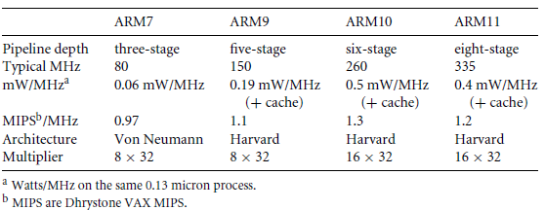
ARM Family Attribute Comparison

Slide 41
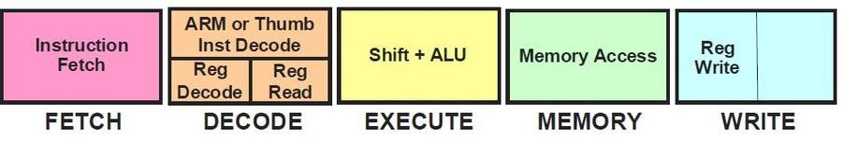
ARM9 5-stage Pipeline Structure
ARM 3-Stage Pipeline
ARM 5-Stage Pipeline

Slide 42
5-stage Pipeline
Breaking instruction execution down into five components rather than three reduces the maximum work which must be completed in a clock cycle
Hence allows a higher clock frequency to be used
Provided that other system components, and particularly the instruction memory, are also redesigned to operate at this higher clock rate
The separate instruction and data memories (which may have separate caches connected to a unified instruction and data main memory) allow a significant reduction in the core's CPI
This is implemented in the ARM9TDMI CPU

Slide 43
5-stage Pipeline: Various Stages
Fetch: The instruction is fetched from memory and placed in the instruction pipeline
Decode: The instruction is decoded and register operands read from the register file. There are three operand read ports in the register file, so most ARM instructions can source all their operands in one cycle
Execute: An operand is shifted and the ALU result generated. If the instruction is a load or store the memory address is computed in the ALU
Memory Access: Data memory is accessed if required. Otherwise the ALU result is simply buffered for one clock cycle to give the same pipeline flow for all instructions
Write-back: The results generated by the instruction are written back to the register file, including any data loaded from/to memory

